Slide 1
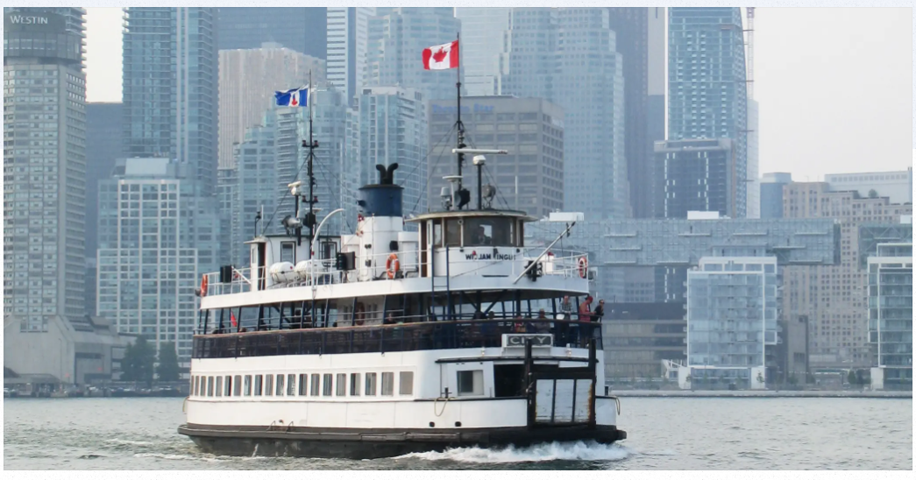

Ferry Ticket Activity Analysis (2015-2025)
A 10-Year Analysis of Ticket Sales and Usage Patterns, Weather Impact & Future Demand Forecasting

Slide 2
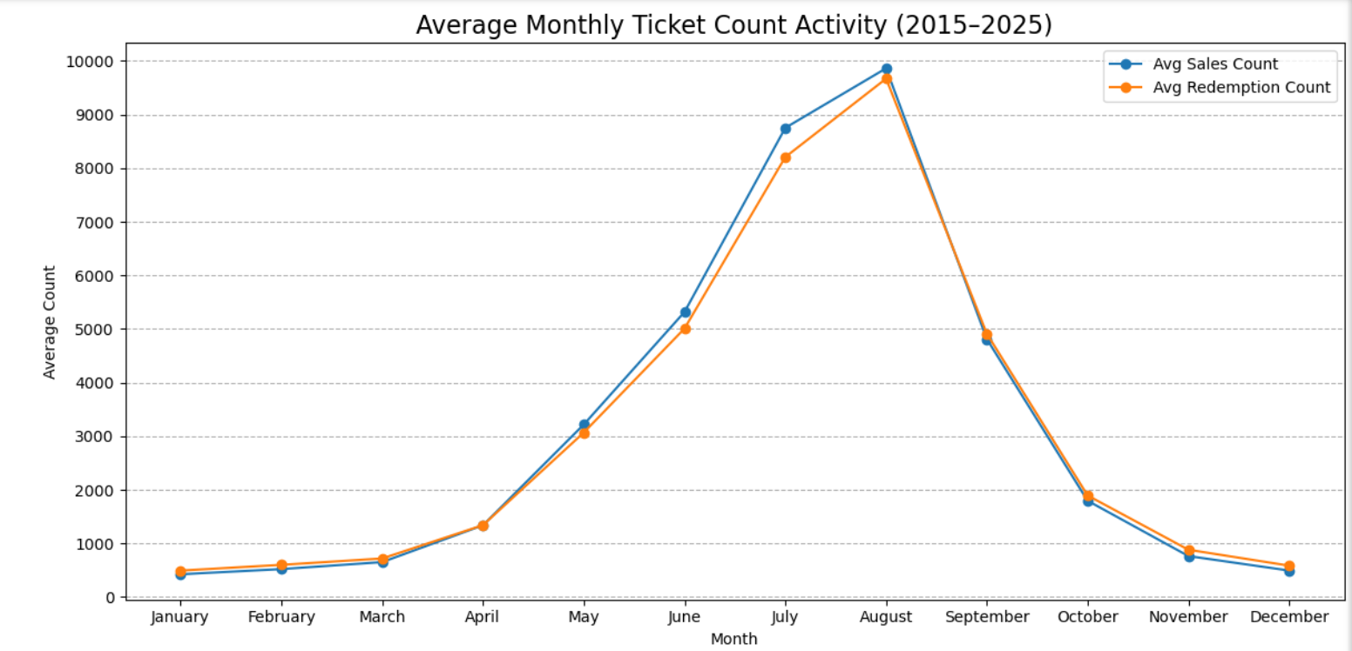
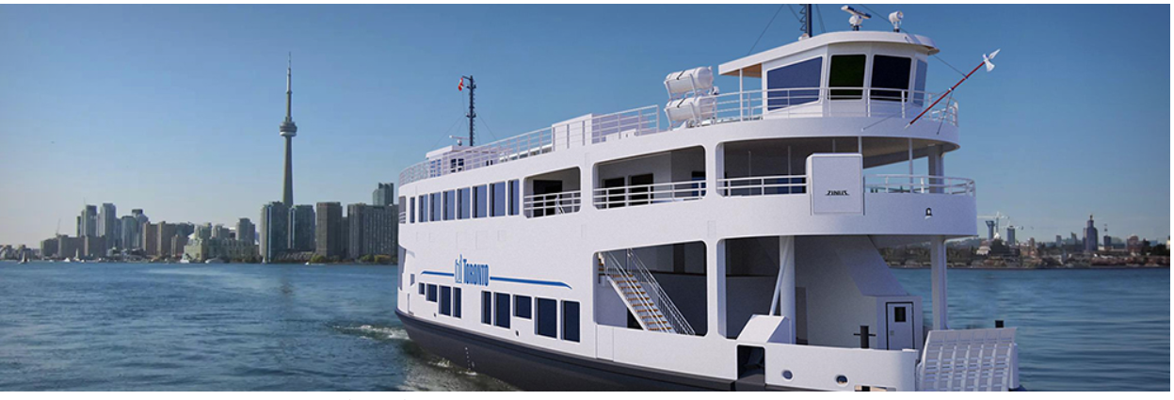
01
Ticket activity peaks during the summer—especially in July and August—with both sales and redemptions reaching their highest levels, highlighting strong seasonal demand likely tied to recreational travel and tourism.
Key Findings from Ferry Ticket Activity
Sales/Redemption peak in summer

Slide 3
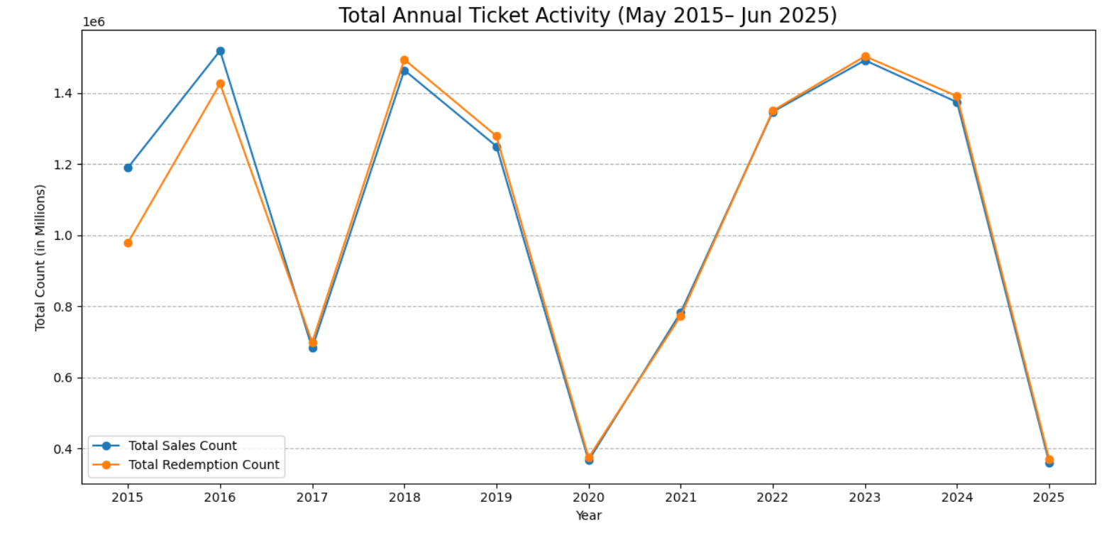
02
Ticket activity shows clear seasonal and external patterns. Peaks occurred in 2016, 2018, 2023, and 2024, likely due to strong summer demand and tourism recovery post-COVID. The sharp dip in 2017 & 2020 reflects likely disaster/pandemic’s impact, while 2025 appears incomplete (only partial year data).
Key Findings from Ferry Ticket Activity
Yearly Ticket Activity peaks and dips
Toronto Island Flood
COVID-19 Lockdown

Slide 4
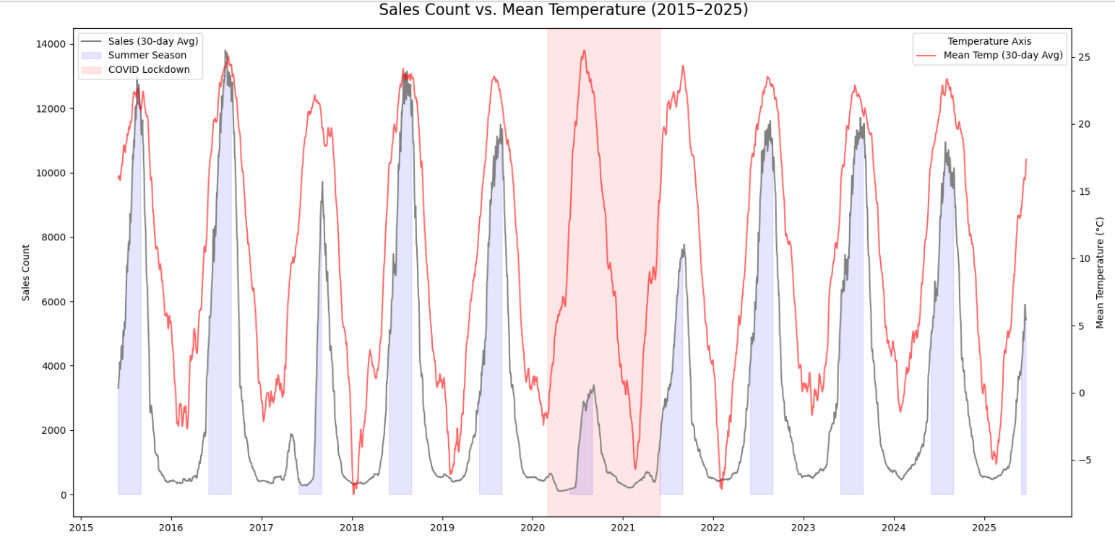
Key Findings from Ferry Ticket Activity
03
Yearly Weather Impact on tickets
The image shows a strong positive relationship between higher temperatures and increased ticket sales, especially during summer months. Cooler periods—like winter or the COVID lockdown—correlate with clear drops in sales. This highlights how favorable weather conditions are key drivers of demand, reinforcing the value of temperature-based forecasting and seasonally targeted marketing.

Slide 5
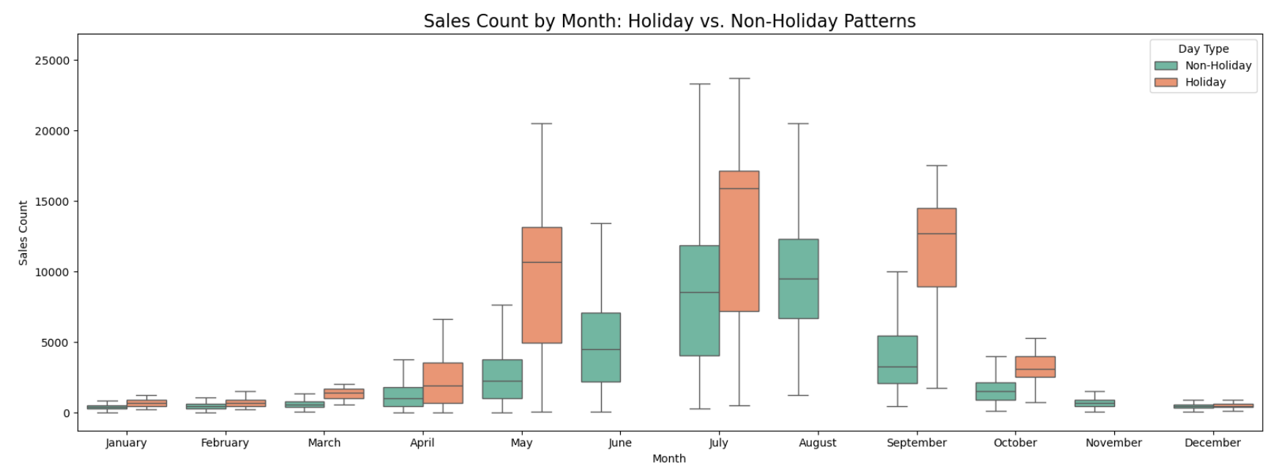
Key Findings from Ferry Ticket Activity
04
Holiday Impact on Tickets
Holiday periods consistently drive higher ticket sales, especially in peak months like May to September. The widest spread and highest medians occur during holidays, suggesting elevated demand and greater variability. This highlights holidays as key opportunities for promotional targeting and capacity planning.

Slide 6
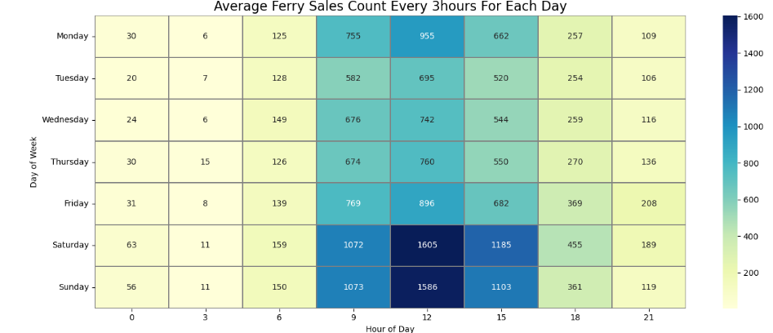
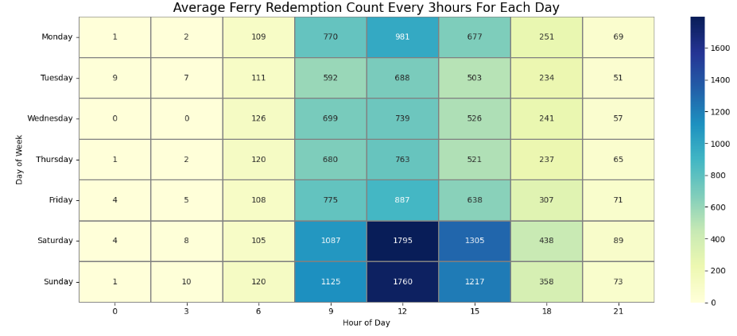
Key Findings from Ferry Ticket Activity
05
3 - Hour's interval ticket activity : Sales vs. Redemption
Sales and redemptions follow nearly identical daily patterns, peaking between 9 AM and 3 PM—especially on weekends. Saturday and Sunday show the highest volumes, with redemption counts slightly higher than sales, indicating people use tickets more on weekend than weekdays.

Slide 7
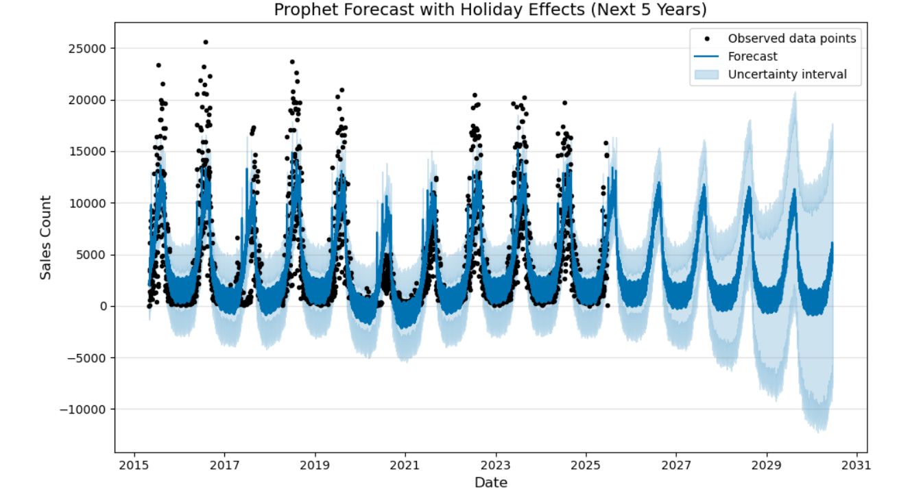
Sales Ticket Forecast
06
Using advanced modeling (Prophet), future ferry ticket sales were forecasted with strong accuracy. The model successfully anticipates annual demand spikes—especially during summer and holidays. Reliable performance metrics (R² = 0.73) indicate this forecast can support better staffing, fleet planning, and holiday marketing decisions.
5-Year Sales Forecast Modelling

Slide 8

Data Methodology
Data Cleaning & Integration:
Loaded 15 minutes’ interval data of Ferry ticket sales. Aggregated to daily interval for better trend and seasonality analysis.
Web scraped daily weather data of ‘Toronto Ontario City’ from https://climate.weather.gc.ca/
Merged daily ferry ticket datasets (sales and redemptions) with daily weather records using a left join.
Handled non-numeric anomalies (e.g., "LegendMM", "LegendEE") and imputed missing values where necessary using surrounding averages. Checked for duplicates, outliers, inconsistencies and data-types.
Feature Engineering:
Introduced flags for weekends, holidays, and season changes, calculated rolling averages to smooth short-term volatility.
Exploratory Data Analysis (EDA):
Conducted trend analysis by day, month, and season to uncover usage spikes, Visualized ticket activity against weather factors
Used heatmaps and correlation plots to assess relationships among key variables.
Visualization for Insights:
Created seasonal line charts, calendar heatmaps, and Prophet forecast plot with labeled axes, legends, and confidence bands to support storytelling.
Time Series Modeling:
Built forecasting model:
Prophet (because it takes note of seasonality): included holiday effects like Canada Day, Civic Holidays, and Christmas. Achieved R² = 0.73 indicating solid predictive performance.
Assumptions Made
There was also decline in ticket sales in 2017 possibly due to internal restructuring.
Assumptions were made for seasons. There could be some overlaps due to climate change
Operational changes (e.g., fare increases or schedule changes) are not explicitly available and thus not modeled.

Slide 9

Exploring Data Opportunities for Deeper Insights
01
Enhanced Weather Data
Incorporating detailed weather data will allow us to analyze its impact on ticket sales more accurately, revealing deeper seasonal trends.
02
Expanded Customer Profiles
Gathering demographic information on customers will help tailor marketing strategies.
Incorporate ticket types (adult, senior, group, etc.) or payment methods to tailor insights for different rider groups for better understanding different segments better.
03
Real-Time Sales/Ops Tracking
Incorporate BI dashboards/reports to monitor Fleet Demands, Fleet in use/repair/break down/maintenance. Also incorporate total sales, demand, weather, precipitation and so on for optimal fleet service delivery.
Fleet Stations, Capacity/Size/pricing
Include ferry capacity, delays, local events, or service charge data to distinguish between demand-side and supply-side impacts for better fleet allocation and cost reduction while meeting demands.
04
05
Advanced Forecasting Enhancements
Fine tune models or try SARIMA or other advanced models for better demand forecasts

Slide 10
Summary and Key Takeway
Covid-19 lockdown created a significant anomaly in sales and redemption count in year 2020-2021
Historical sales patterns are consistent and predictive of future behavior except for external disruptions.
Weekend and Holidays have a significant effect on demand — particularly statutory holidays and long weekends.
Summer Season and Weather impacts ferry demand linearly (e.g., warmer days’ correlate with higher sales).

Slide 11
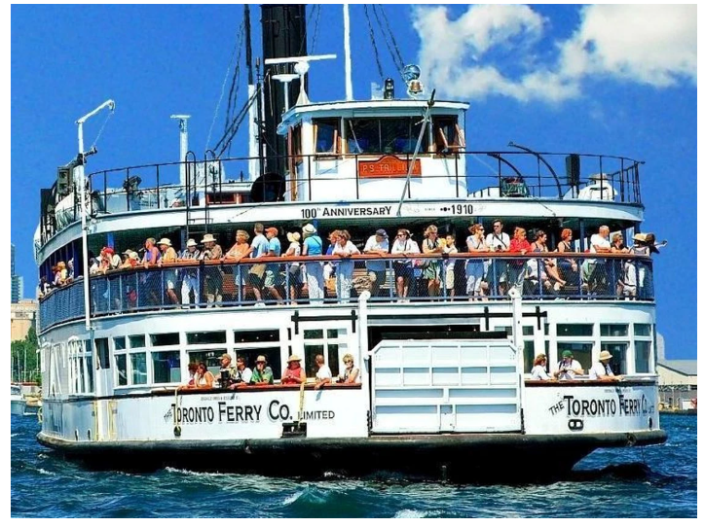
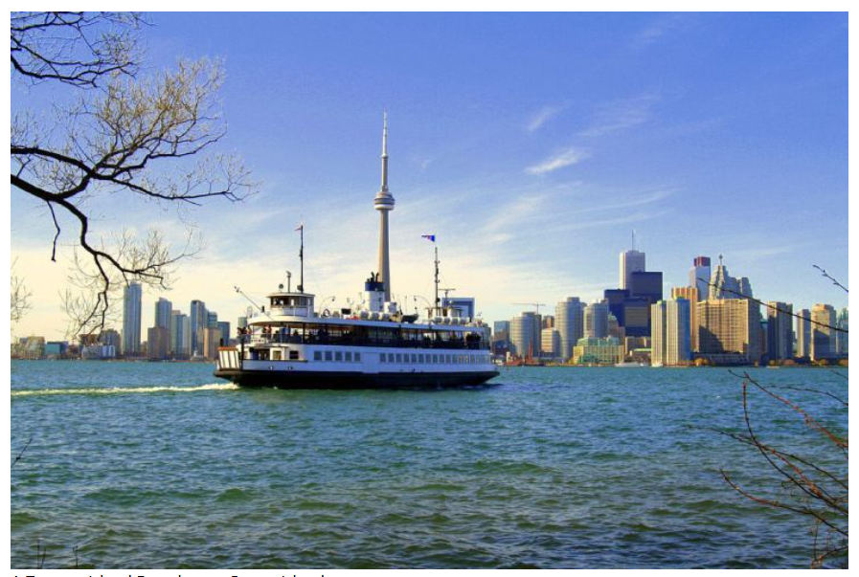
“Data Insight can help TorontoCity plan smarter Ferry Operations year-round.”
Thank you
By leveraging data-driven insights and proactive strategies, we can shape our FSD’s business's success and navigate the challenges ahead.

